Slide 1
2020 Science Olympiad Competition- JHU Workshop
Department of Earth and Planetary Sciences
Johns Hopkins University

Slide 2
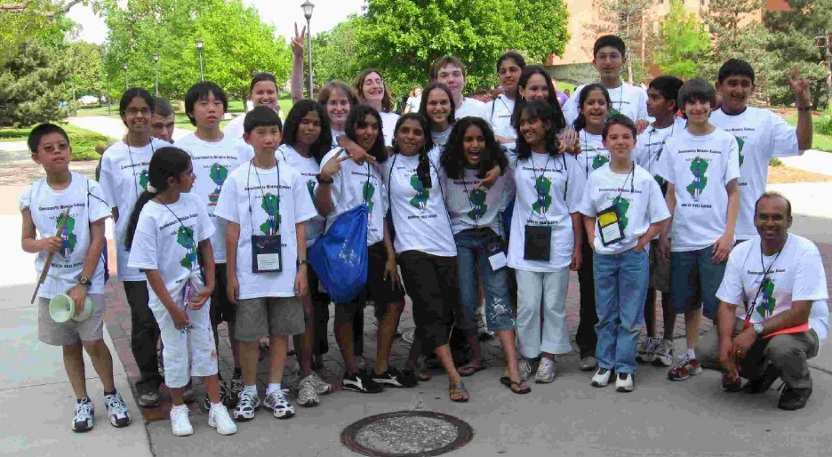
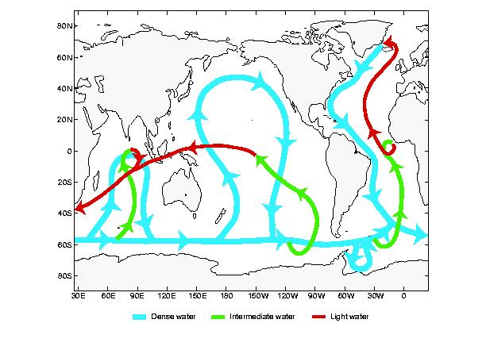
A little about me…
Former Science Olympiad parent.
Coach (Community Middle School 2004-2007, West Windsor Plainsboro HS- North, 2007-2010,Barclay 2012-2013, Falstaff 2015-present)
Event coordinator (2004-)
Dynamic Planet
Road Scholar
Fermi questions
Remote Sensing
Geologic mapping
Others….
Currently chair fo the Dept. of Earth and Planetary Sciences, Johns Hopkins University

Slide 3
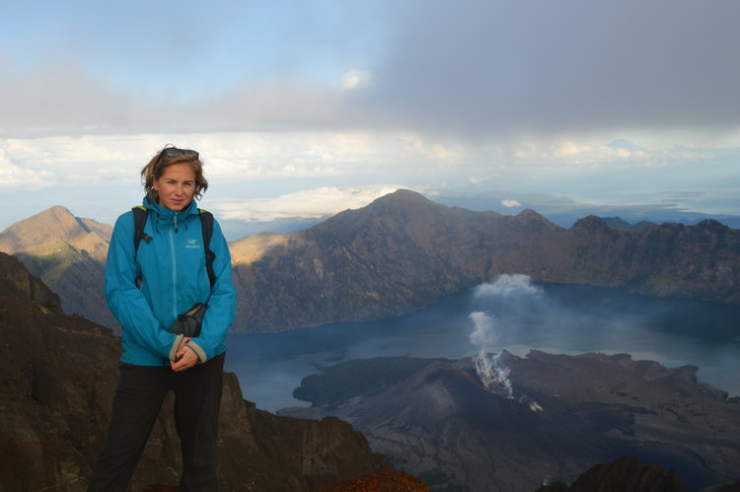
Also here today
Professor Emmy Smith
Fossils
Geologic mapping
Authority on Earth’s earliest life
Intrepid explorer

Slide 4
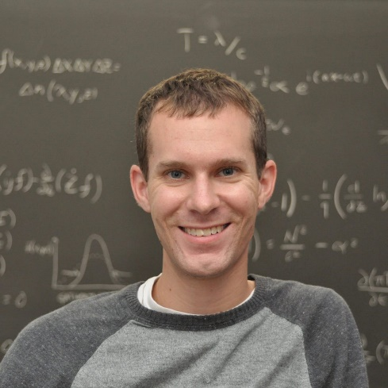
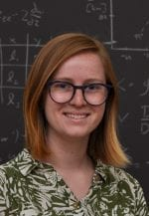
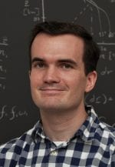
Chris Holder
Biological oceanographer
Water quality
Mary Lonsdale
Geologist
Kalev Hantsoo
Paleoceanographer, marine biogeochemist

Slide 5
What are the study events
Three types
Knowledge events
Process events
ID events
Middle school
Equivalent of freshman year college material for nonmajors with minimal math.
High school
Equivalent of freshman year college material for majors. Some math

Slide 6
Study events, preparing your team
Read the rules.
Figure out what materials are allowed (some events allow notes, others do not)
Make a binder- Go through the material and have the students make notes on everything in the outline.
Have the students make up tests from the binder and test their partners.

Slide 7
How to help your students
Get used textbook.
Assign material
Help them with processes
How to read a line plot
How to make a line plot
How to read a contour plot
How to make a contour plot

Slide 8
Schedule for today
10:15-11:05 Oceanography/Fossils
11:05-11:55 Water Quality/Fossils
11:55-12:30 Lunch
12:30-1:15 Meteorology/Geologic Mapping
1:15-2:00 Astronomy events (in main auditorium)

